Slide 1


NLP News Classification
Presented by: Hanan Salih Shahad Abdulbari Raheed Fadi
Supervised By: Dr. Ali Mohsin

Slide 2
Table of contents
01
02
03
05
06
07
04
Introduction
Problems
Objectives
Methodology
08
Examples
Dataset & GUI
Results
Conclusion

Slide 3
Introduction
The primary purpose of news is to keep people informed about events that are taking place in their environment that may influence them.
Individuals have their own preferences for news categories based on different interests.
People read the news for various reasons—some to stay informed about current events, others to prepare for exams, or simply as a hobby.
Notes:
tosha

Slide 4
Problem Statement:
Three problem statements highlighted in this study.
How to build a model to classify news articles according to their contents ?
How to extract features from news articles?
How to evaluate the classification models performance?
Notes:
raheed

Slide 5
Project Objectives:
To classify news using three algorithms: SVM, NN, RF.
To exploit two types of feature extraction (TF-IDF and BOW) that can extract a meaningful information and remove others.
To use precision, recall, f-score, accuracy and time metrics for evaluation models.
Notes:
raheed

Slide 6
Methodology
Testing data 20%
News Articles
Data cleaning and preprocessing
TF-IDF & BOW vectorization
Training data 80%
Applying
SVM & NN & RF
News Category Classification
Evaluation
Notes:
tosha

Slide 7
TF-IDF example
Examples
Word frequency within a document (TF) and its frequency throughout the corpus of documents (IDF).
We give each word a score that represents its significance within the document and corpus. Depending on this significance values the document will be classified to its belonging class.
We will cover an example of three documents:
Document 1: It is going to rain today.
Document 2: Today I am not going outside.
Document 3: I am going to watch the season premiere.
Notes:
shahad

Slide 8
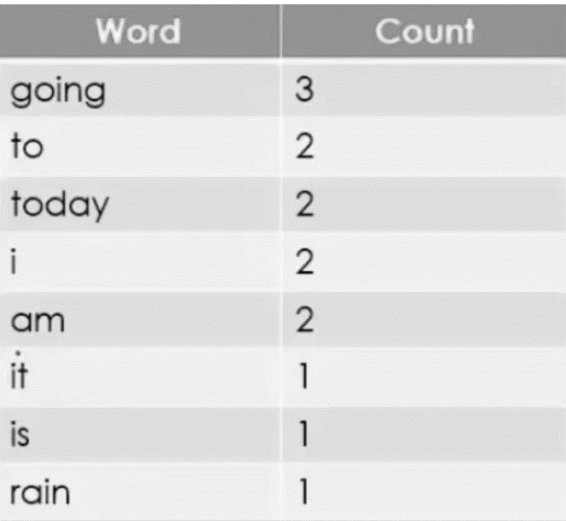
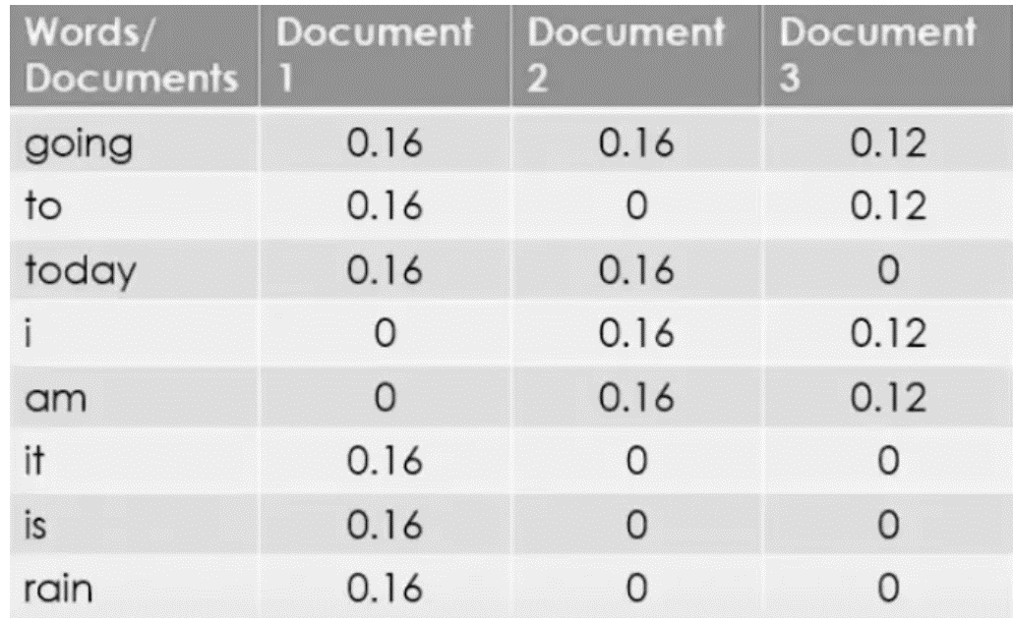

TF-IDF example
1. Clean data and Tokenize:
2. Find Term Frequency:
$$TF = \frac{Number of repetitions of word in a document}{Number of words in a document}$$

Slide 9
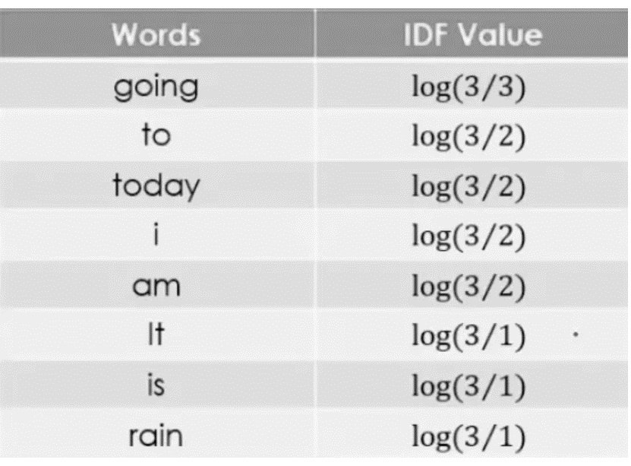

TF-IDF example
3. Find Inverse Document Frequency:
$$IDF =Log[\frac{ Number of documents}{Number of documents containing the word}]$$

Slide 10
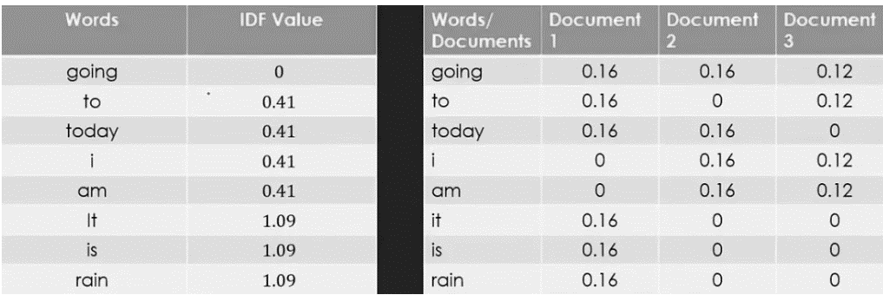
TF-IDF example
4. IDF and TF values for three documents:

Slide 11
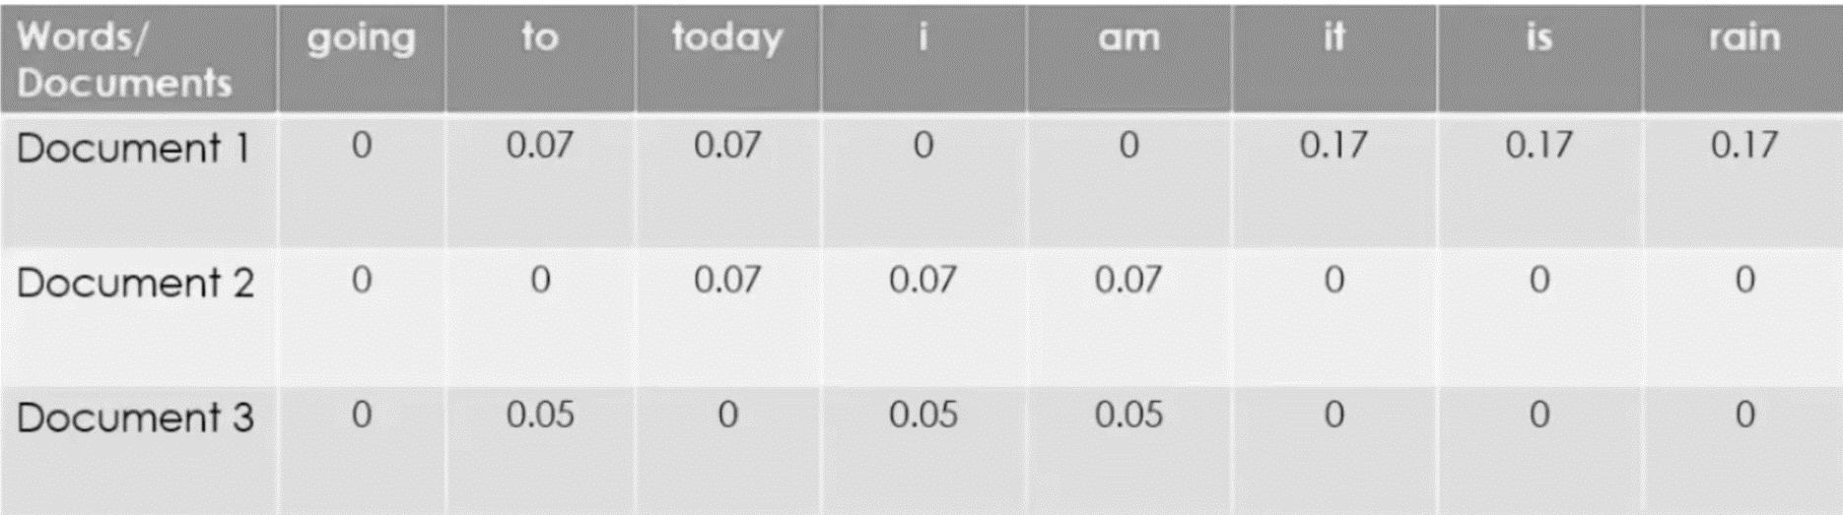
TF-IDF example
Calculate the final equation & compare result:
$$TF−IDF = TF ∗ IDF$$

Slide 12
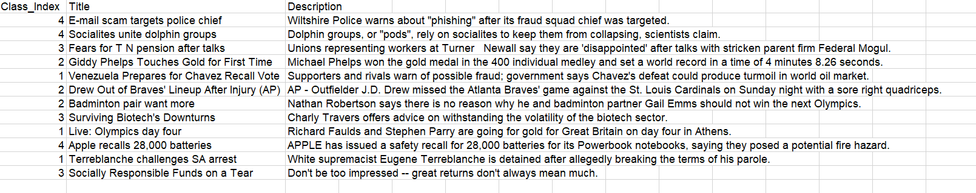
Dataset
The AG News Classification Dataset is about news articles, it has 4 classes type either World, Sports, Business or Sci/Tech.
Our dataset has 120,000 records they're divided into two parts 80% for training and 20% for testing, evenly distributes across the four classes.
Notes:
tosha

Slide 13
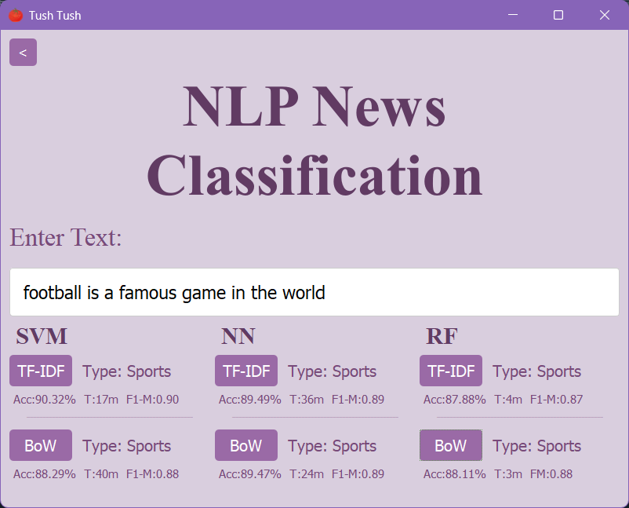
GUI
Notes:
raheed

Slide 14
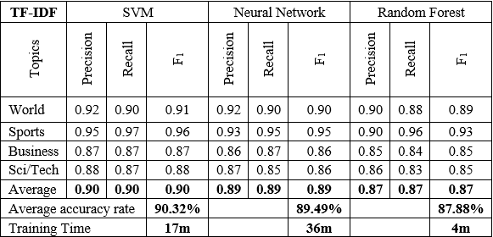
Results
TF-IDF Results table: SVM highest accuracy, the RF is faster.
Notes:
shahad

Slide 15
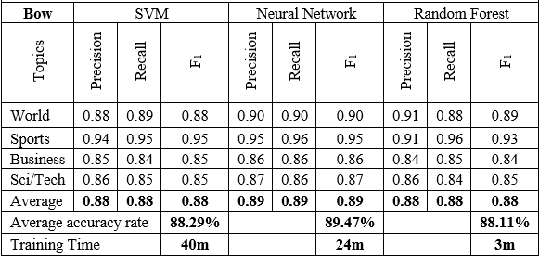
Results
BoW Results table: almost all three are equally accurate, but RF was faster.

Slide 16
Compare Results
TF-IDF comparison results:

Slide 17
Compare Results
BoW comparison results:

Slide 18
Conclusion
The study classifies news articles into four categories using SVM, Neural Networks, and Random Forest algorithms.
Results show that SVM with TF-IDF achieves the highest accuracy, making it ideal when precision is key.
Random Forest with BOW is faster and suitable for efficiency-focused tasks with moderate accuracy.
Neural Networks perform well but require significant computational resources, fitting for large-scale setups.
Future work could explore combining TF-IDF and BOW or hybrid models, along with testing on additional datasets for more robust evaluation.
Notes:
tosha

Slide 19
Thanks!

